Slide 1
ART 1600 – The Aesthetics of Architecture, Interiors, and Design Matthew Ziff, Associate Professor, Interior Architecture Area Chair Spring Semester 2017
Historical Overview: Part 5
Catalog Houses
Post Modernism

Slide 2
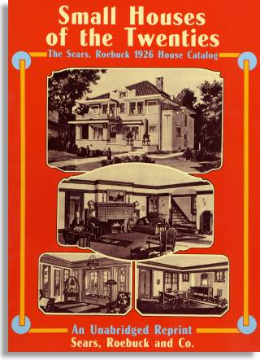
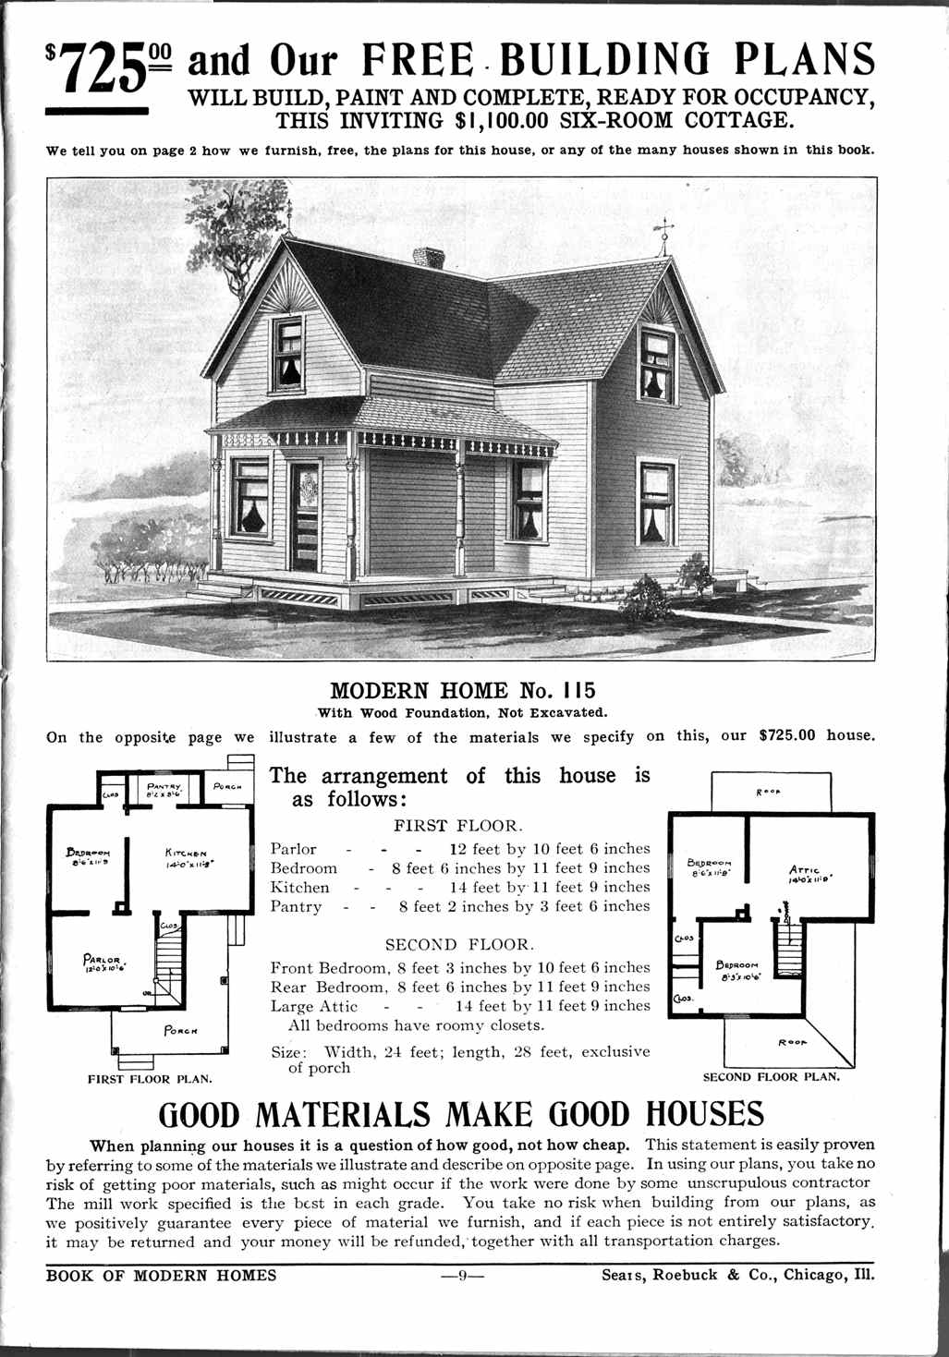
Catalog Houses America’s First Pre-Fabricated Housing 1910 - 1940

Slide 3
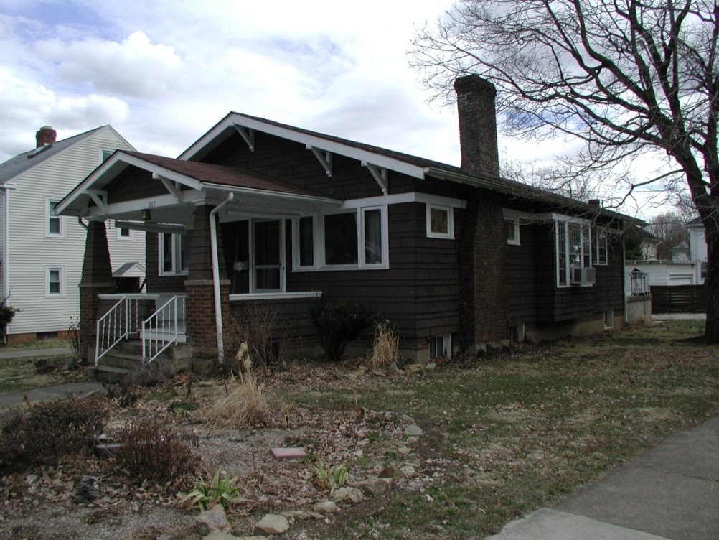
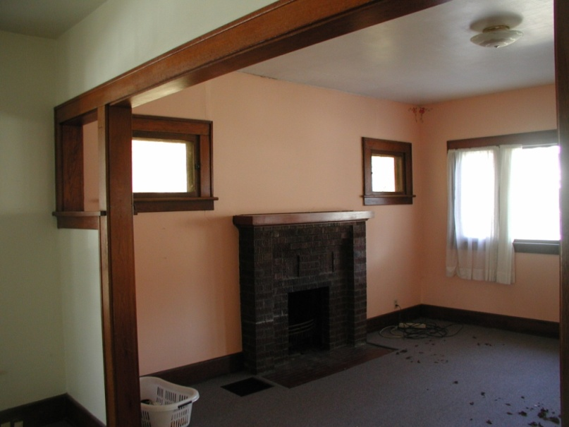
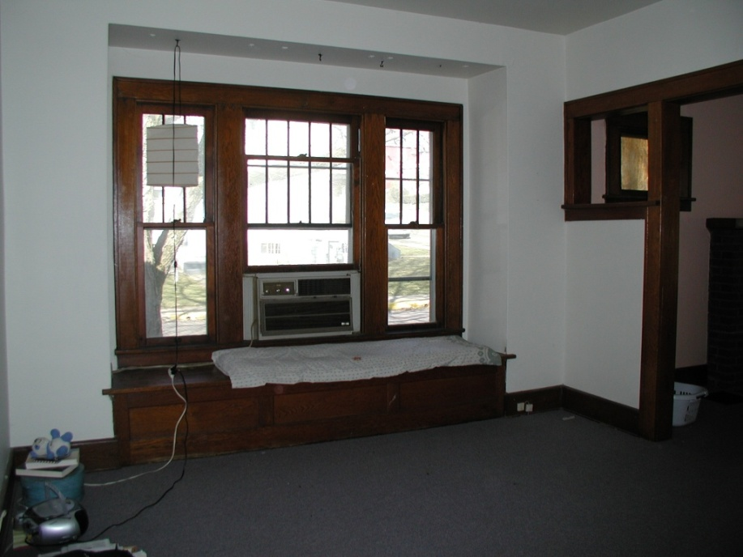
Athens has many catalog houses

Slide 5
The beginning of American prefabricated housing was in 1908 with Sears Roebuck’s pre-cut kit homes.
This new version of the modern home offered many designs in a printed catalog and even the possibility of a homeowner designing their own home — which Sears would pre-cut.
Sears’ first ‘Modern Home’ catalogue offered 22 different kit designs and ranged in cost from just $650 to $2500 (20-60k in 2011 dollars).

Slide 6
Sears Catalog Houses
Sears’ offer gave Americans the popular styles they were seeking, as well as up-to-date floor plans that didn’t require an architect.
The option was also easily constructible, coming in a package of framing and trim materials that arrived by rail.
The style, the convenience and the savings that resulted from reduced design fees and efficient on-site framing were attractive enough to consumers to earn Sears over 70,000 customers between 1908 and 1940.

Slide 7
More than just creating a space, Sears’ strategy was to eventually sell the home-building customer all the finishes, furnishings, plumbing and heating equipment — all available in the Sears main retail catalogue.
Seeing the effectiveness of their plan, other mass merchandisers, such as Montgomery Ward, quickly followed suit.

Slide 8
By 1920 kit houses were popular with consumers, but the movement lost speed when many homeowners naively thought they could save substantially by building their own home.
This disastrous misconception was memorialized in the Buster Keaton silent movie, One Week, in which a newlywed couple attempts to build a kit home.

Slide 9
Did your old house come "in the mail"? Between 1906 and 1940, thousands of North American homes were built according to plans sold by mail order companies such as Sears and Montgomery Wards.
Often the entire mail order house (in the form of labeled timbers) came via freight train.
Other times, builders used local materials to construct homes according to the mail order catalog house plans.
Catalog house plans by Sears, Montgomery Wards, Aladdin, and other companies were widely distributed in the United States and Canada.

Slide 10
How do you find Sears houses? It's not easy.
Start your search with a reference work, such as "Houses by Mail: A Guide to Houses from Sears, Roebuck and Company," or Dover Publishing's reprint of the 1926 Sears Modern Homes catalogue.
Study front porches and roof lines.
Original front porches can have several easy-to-spot clues.
Look at the stick-work on the front porch columns and the interesting millwork on the 3-part front porch columns.
Note the small block of wood, centered on the front porch roof's trim. The roof line of the Sunbeam and Windsor extends much further on the front of the house than the back.

Slide 11
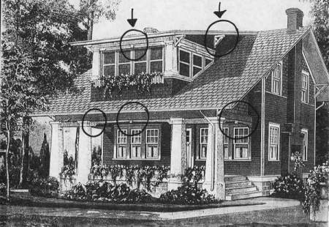
‘The Sunbeam’ catalog house. Note the interesting millwork on the porch of this Sunbeam house in the catalog picture

Slide 12
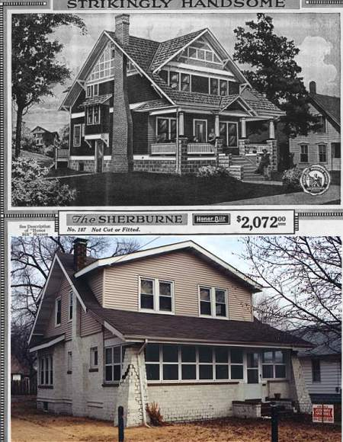
catalog houses

Slide 13
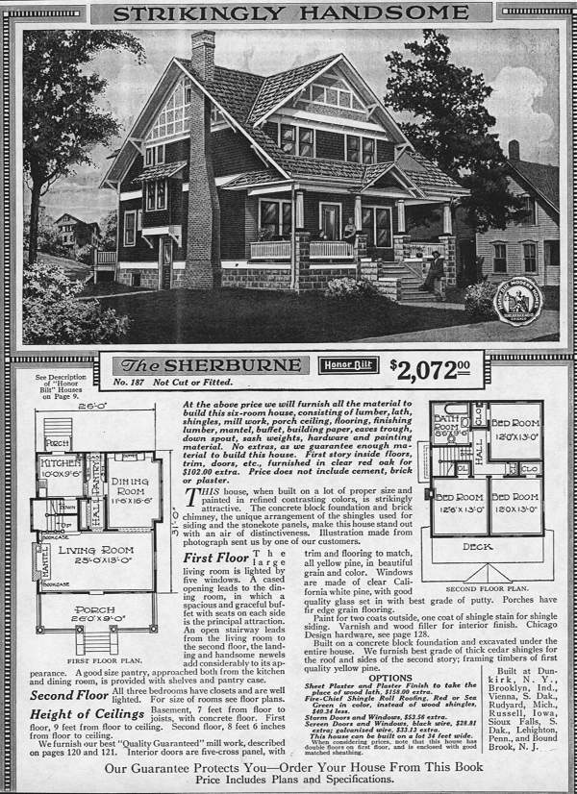

Slide 15
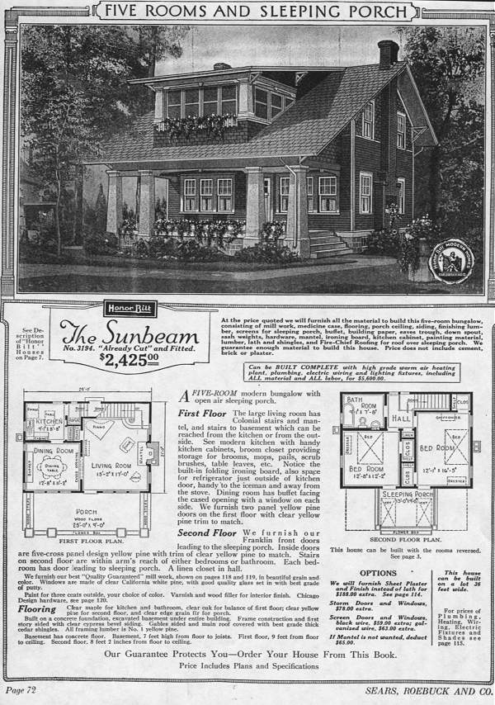

Slide 16
Sears Catalog Homes 1908 – 1940
Sears Catalogue Homes - Between 1908 and 1940, Sears customers ordered over 75,000 houses from Sears Roebuck and Company mail-order catalogs.
Prices for these build-it-yourself kit houses ranged from $600 to $6000.

Slide 17
The customer selected a house design from the Sears Modern Homes catalog.
They received a bill of materials list and full blueprints.
A few weeks after the order was placed, two boxcars containing approximately 30,000 pieces of house would arrive at the nearest train depot.

Slide 18
A 75-page instruction book told homeowners how to assemble those pieces.
The best way to identify a Sears home is to obtain a copy of the original Houses By Mail catalogue.

Slide 21
How To Find Sears Modern Homes Old House Web: Ideas & Advice for Old House Enthusiasts

Slide 22
Catalog Home Interiors almost every item found in a house was included in the catalogs

Slide 24
1921 Sears Catalog kitchen

Slide 25
Sears Catalog Houses
Sears Kit Houses - 1916 Interiors and Millwork - Original Pictures of Sears Kit Homes
Sears catalog houses: big houses!
Sears Sold Everything
University District History, Columbus, Ohio

Slide 27
Catalog House vs Levittown
The catalog houses were a form of pre-fabricated housing: kits that contained everything needed to construct a working house.
Levittown, in contrast, was a planned ‘community’ consisting of many houses of four or five variations on a plan, using a ‘mass production’ approach. Teams of trade specific workers repeated their particular job over and over: concrete workers poured foundation slabs, carpenters built stud walls, roofers laid down shingle roofs, et cetera.

Slide 28
History of Levittown (a 3 minute video) Levittown, built by William Levitt, “father of modern suburbia”

Slide 29
How Many Levittowns Were Built in the Post–World War II Era?
There were three pioneering suburban housing developments bearing the Levittown name:
one in Hempstead, New York, in the late 1940s
one near Philadelphia in the 1950s
one in New Jersey in the 1960s.

Slide 30
The Levittown Story (a 5 minute video)
15,000 home planned suburban community.
Mass Produced Homes. (200 per week - similar in design)
Relies on the use of automobiles for commuting.
No mixed use, or variation in culture. (No variation in color of home, no fences, no clothes hung to dry outside.)
Early in the history of Levittown (1950’s) the owners refused to sell to African Americans.
A Totally Planned Community: contained Churches, Schools and Shopping

Slide 31
Levittown
As the first and one of the largest mass-produced suburbs, Levittown quickly became a symbol of postwar suburbia.
Although Levittown provided affordable houses in what many residents felt to be a congenial community, critics decried its homogeneity, blandness, and racial exclusivity (the initial lease prohibited rental to non-whites).

Slide 32
Today, the name "Levittown" is used as a term to describe overly sanitized suburbs consisting largely of identical housing
Levittown is a hamlet in the Town of Hempstead located in Nassau County, New York on Long Island.
Why Build Levittown?

Slide 33
1970: Modernism begins to lose its appeal
High ‘Modernism’ with its optimistic call for functional, clean lined, non-ornamented design played a large role in the great urban developments of the 1950’s and 1960’s.
The large cities of Europe and America in particular grew tremendously during these two decades and most of the buildings that went up during this time were ‘Modern’ in character. Glass faced boxes with flat roofs described many high rise building designs.

Slide 34
Many designers asked “Why not do this?”

Slide 35
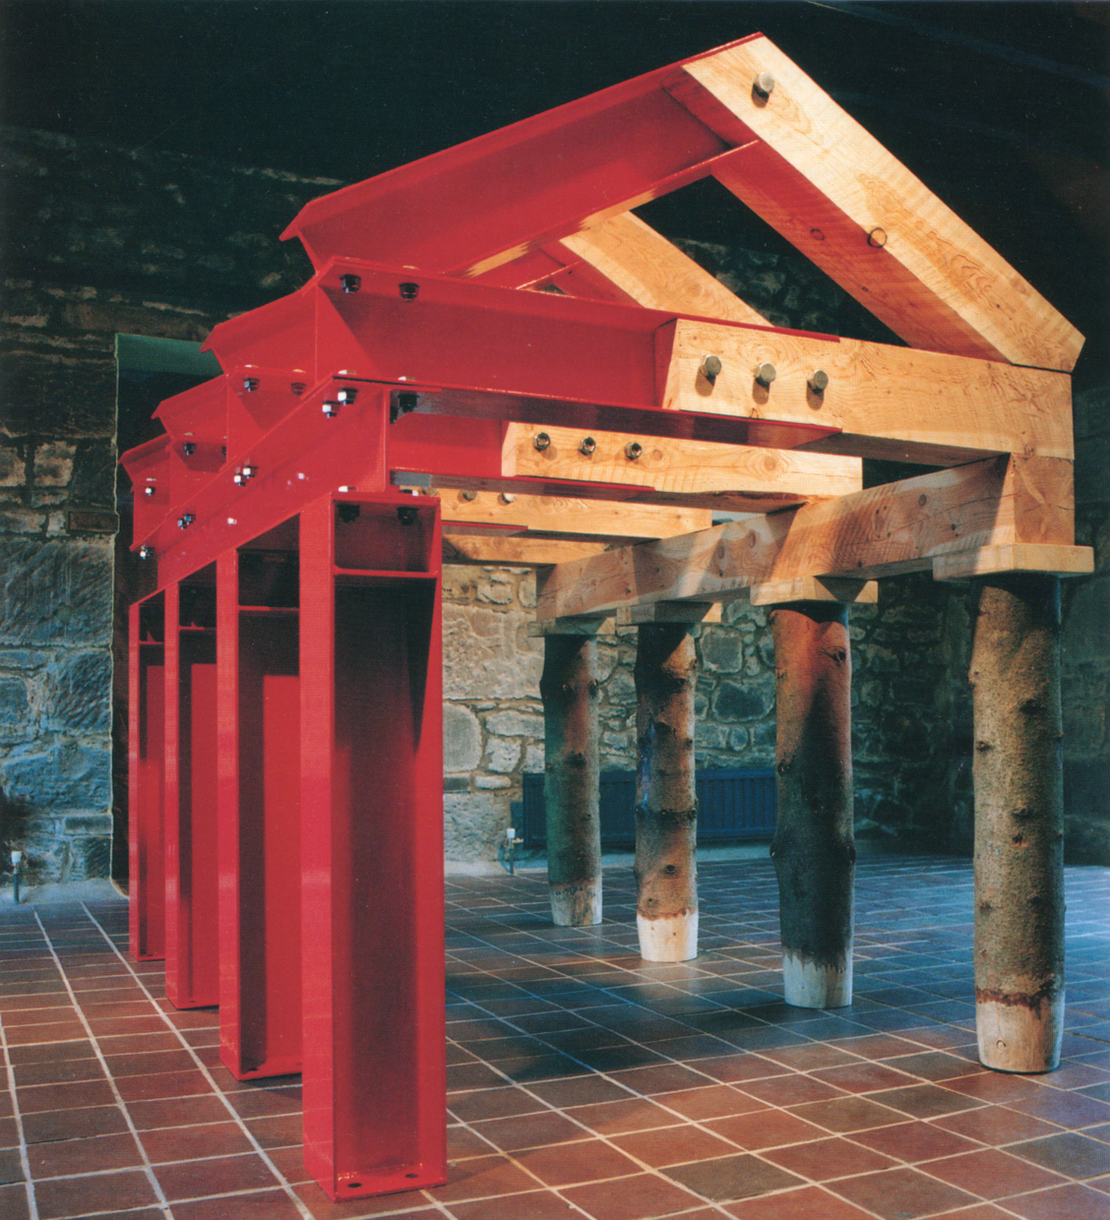
Postmodernism: An intellectual movement beginning in the 1960’s, peaking in the 1980’s, that spread across many disciplines, including philosophy, literature, architecture, and music.

Slide 36
What is postmodernism?
Postmodernism describes not only a period but also a set of ideas, and can only be understood in relation to another equally complex term: modernism.
Postmodernism is best understood as a questioning of the ideas and values associated with a form of modernism that believes in progress and innovation. Modernism insists on a clear divide between art and popular culture.
Postmodernists believe in messy complexity in place of Modernism’s clean simplicity.

Slide 37
The following images all depict ‘post modern’ design.

Slide 38
Robert Venturi chair: mocking Gothic Revival style

Slide 39
Michael Graves, 1982, ‘Portland Building’ Post Modern exaggeration of classical elements

Slide 40
Michael Graves, 1982, ‘Portland Building’ Post Modern exaggeration of classical elements

Slide 41
Charles Moore, ‘Piazza d’Italia’, New Orleans, 1978

Slide 42
Charles Moore, ‘Piazza d’Italia’, New Orleans, 1978

Slide 43
Team Disney Building, in Burbank, CA: a good example of how postmodernism pokes fun of different styles. It mocks the seriousness of the neo-classical style using the dwarfs as the columns.

Slide 44
The rise of ‘Post Modern’ design
The functional and formalized shapes and spaces of the modernist style are replaced by diverse aesthetics:
styles collide, form is adopted for its own sake, and new ways of viewing familiar styles and space abound.
Perhaps most obviously, architects rediscovered the expressive and symbolic value of architectural elements and forms that had evolved through centuries of building which had been abandoned by the modern style.

Slide 45
a tea pot Michael Graves 1983

Slide 46
AT&T building, New York Phillip Johnson1984

Slide 47
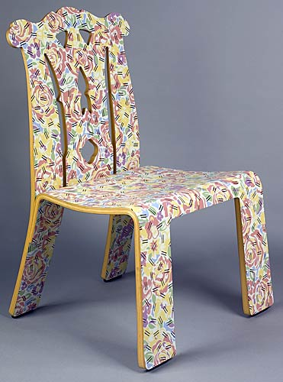
Chair Robert Ventruri & Denise Scott Brown 1984

Slide 48
Robert Venturi & Denise Scott Brown

Slide 49
“Joe” glove chair, 1973 named for Joe DiMaggio designed by Jonhatan De Pas, Danato D’Urbino and Paolo Lomazzi

Slide 50
Ettore Sottsass & ‘Memphis’
Sottsass is not only one of the most influential designers of the latter half of the twentieth century but also one of the most paradoxical.
While he has had a successful career producing industrial designs for the mainstream corporation Olivetti, for everything from typewriters and computers to office landscapes, he has also created strikingly unconventional consumer-oriented objects that challenge the bourgeois audience at which they are aimed to reassess its assumptions of the limits of "good taste."

Slide 51
Sottsass (1917-2007) is now remembered most as the founder of Memphis, the design collective whose much-imitated works released a flood of wonky angled, brightly coloured furniture in laminated plastic, striped, polka-dotted and leopard-skinned, on the 1980s.
Memphis was launched in a Milan gallery in September 1981, in a near riot of 2,000 people (amazing that furniture can arouse such passions). Its original pieces now sell in auction houses for prodigious sums.

Slide 52
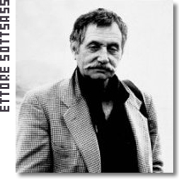
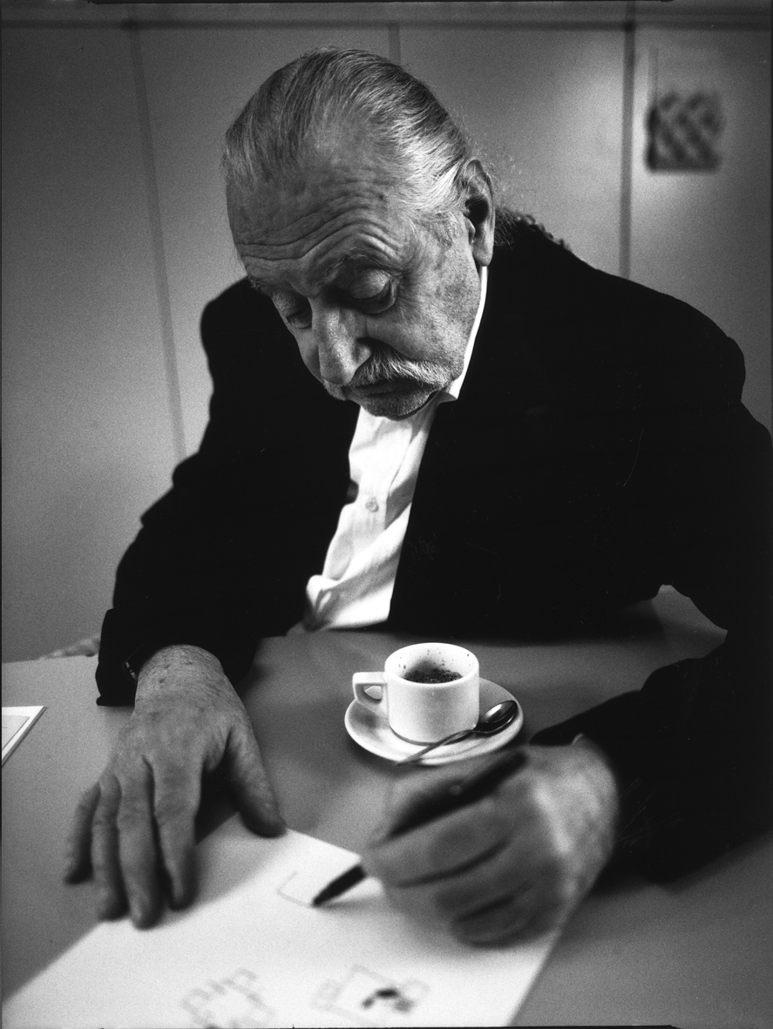
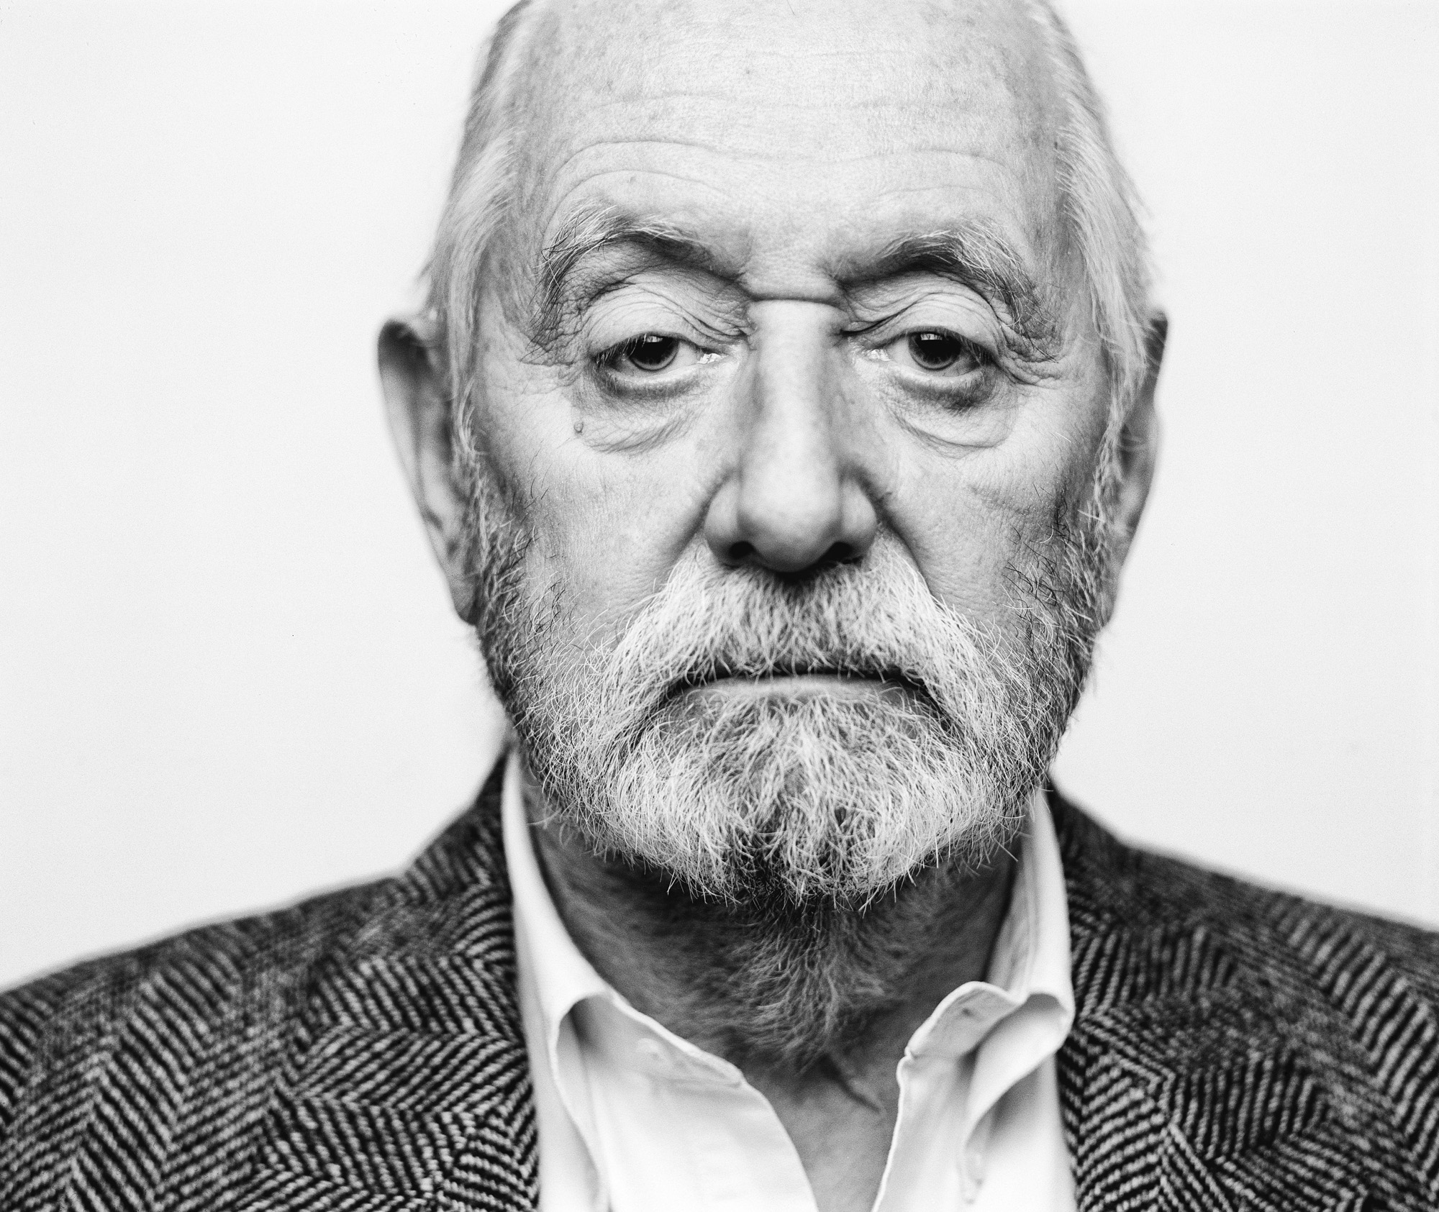
Ettore Sottsass: The Godfather of Italian Cool

Slide 53
Room divider 1981 Ettore Sottsass

Slide 55
Ettore Sottsass, Italian designer, founder of ‘Memphis’

Slide 56
An Ettore Sottsass sofa

Slide 57
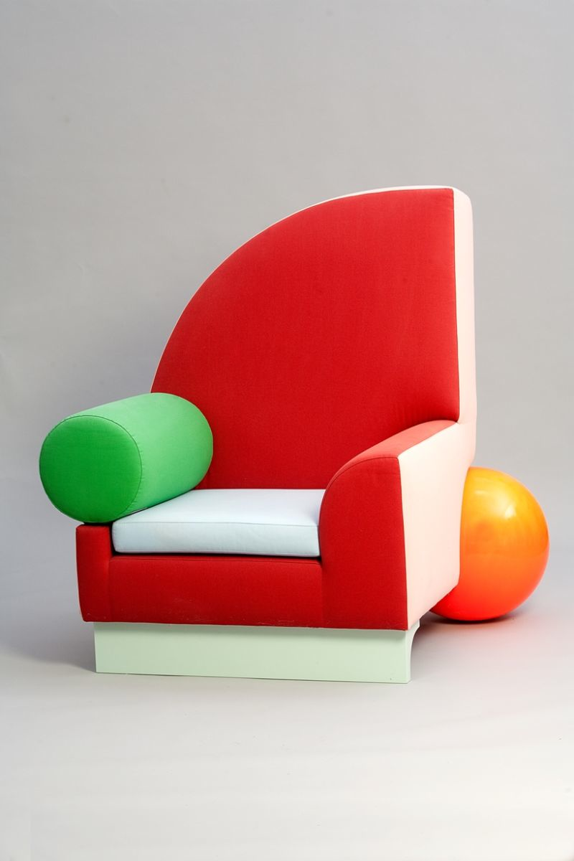
a post modern chair Peter Shire’s 1981 ‘Bel Air’ chair

Slide 58
‘Lido’ sofa by Michele De Lucchi for Memphis, 1982.

Slide 59
Between 1981 and 1988, Sottsass and a small international group of like-minded designers who called themselves Memphis created nonconformist furniture.
The "Carlton" room divider is an example of Memphis designs.
Although intended for a luxury market and of fine workmanship, it is made of cheap plastic laminates rather than fine woods.
The vivid colors and seemingly random interplay of solids and voids suggest avant-garde painting and sculpture.
Yet, typical of Sottsass, underlying the surface brilliance is an entirely logical structural system, of real and implied equilateral triangles.

Slide 60
Best Products SITE Architecture 1974

Slide 61
Best Products “Tilt” Showroom, 1978

Slide 62
Longaberger corporate headquarters, Ohio: More ‘novelty’ than Post Modern

Slide 63
Post Modern Design

Slide 64
Postmodernism
A reaction to and rejection of much of what Modernism was about.
In particular Post-Modernism attacks the use of sharp binary classifications such as male versus female, straight versus gay, white versus black, and imperial versus colonial.
Instead it holds realities to be plural and relative, and to be dependent on who the interested parties are and the nature of these interests.
It claims that there is no absolute truth and that the way people perceive the world is subjective.

Slide 65
Post Modernism
Postmodernism has influenced many cultural fields, including religion, literary criticism, sociology, linguistics, architecture, history, anthropology, visual arts, and music.

Slide 66
Post-Modernism and Architecture
Within architecture, Post Modernism began as a response to the perceived blandness, hostility, and Utopianism of the Modern movement.
Modern Architecture, as established and developed by people such as Walter Gropius, Le Corbusier, and Philip Johnson, was focused on the pursuit of a perceived ideal perfection, and attempted harmony of form and function, and dismissal of "frivolous ornament.”
Postmodernist architecture was one of the first aesthetic movements to openly challenge Modernism as antiquated and "totalitarian", favoring personal preferences and variety over objective, ultimate truths or principles.

Slide 67
Robert Venturi, American architect, wrote “Complexity and Contradiction in Architecture” , 1966
Messy vitality, and richness over simplicity.
and clarity.
Many levels of meaning, a combination of visual forms, decoration and ornament for its own sake
Mixed media, symbolism, representationalism, and starting with the users value system rather than seeking to impose the designer’s values on the user.

Slide 68
Postmodernism
Postmodernism is more than a stylistic term.
Postmodernism is a shift in the philosophy of architecture and the arts.
Postmodernism mixed “high art” and “popular culture”.
Postmodernism extended deeply into consumer society.

Slide 69
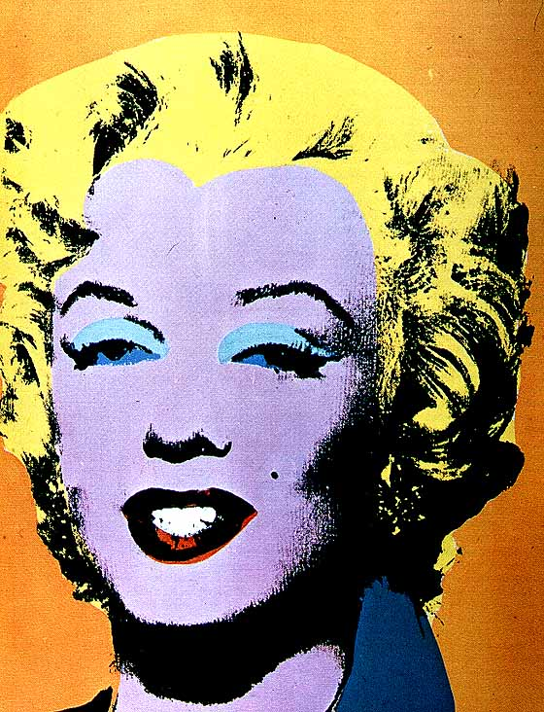
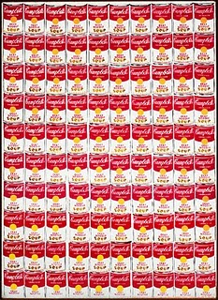
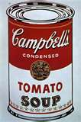
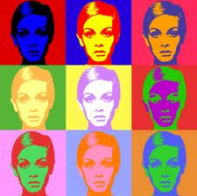

Slide 70
Postmodernism
…the postmodern typically subverts traditions from within through a form of double coding.
It accepts conventions in order to criticize and extend modern, the classical and other traditions.
--Antonia Reeve

Slide 71
Characteristics of Postmodernism
Subvert Traditions – to undermine, destroy, or overthrow time-honored practice, modes of thought or behavior that have been previously followed.
Double Code – pluralistic, holding more than one belief at a time. (An age of uncertainty rather than a time of certainty)

Slide 72
What is Pluralism? The simultaneous acceptance of ‘X’ and ‘-X’
Fusion Cuisine – Mixture of Ethnic Foods
Tex-Mex-Wontons
Multiple Religions in a Single Society
Cable Television (CNN War Coverage and the Cartoon Network)
Darwin and Creationism
Ideas and concepts that are linked but inherently different or contradictory.

Slide 73
Postmodernism
Robert Venturi, architect, furniture designer, educator wrote “Complexity and Contradiction in Architecture”
Published – 1966: a very influential book about post modern design ideas.
Venturi looked at history as an important part of the what influences design.
‘Both – And’ as opposed to the singular, ‘Either – Or’ view of Modernism.

Slide 75
Robert Venturi “Mother’s House” Chestnut Hill, PA, 1964

Slide 76
Chestnut Hill House
Designed by Robert Venturi, 1964 Philadelphia
Built for his widowed Mother
House looks “plain” but embodies “Complexity and Contradiction” ideas through elaborate design.
Looks at the home “architecturally and culturally”
Venturi plays on the simple, iconic, image of the home, but not in a condescending way.

Slide 77
Chestnut Hill House
“Tension between sophisticated architecture and basic, plain house-ness.”
House begins symmetrical, but is twisted out of symmetry.
Influenced other homes as a classic example of postmodern architecture.
Façade is deliberately over scaled, gable is larger than necessary.
Gable refers to a grand manner, but visual emphasis is given to the chimney.

Slide 78
Chestnut Hill House
Chimney emerges from an off center point.
Windows emphasizes asymmetry.

Slide 80
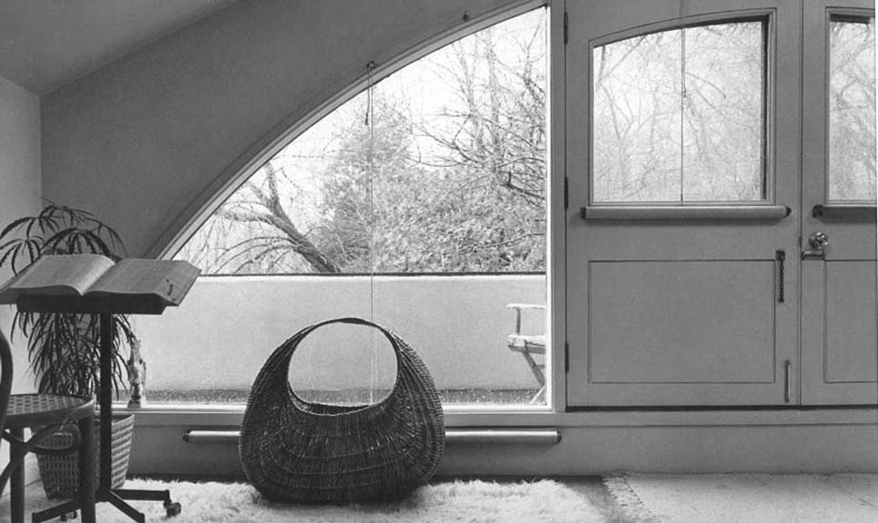

Slide 81
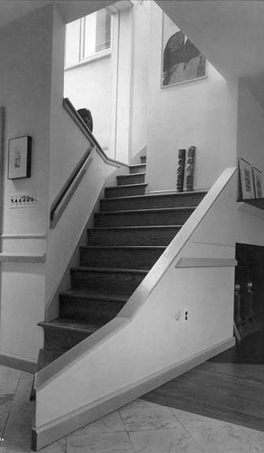
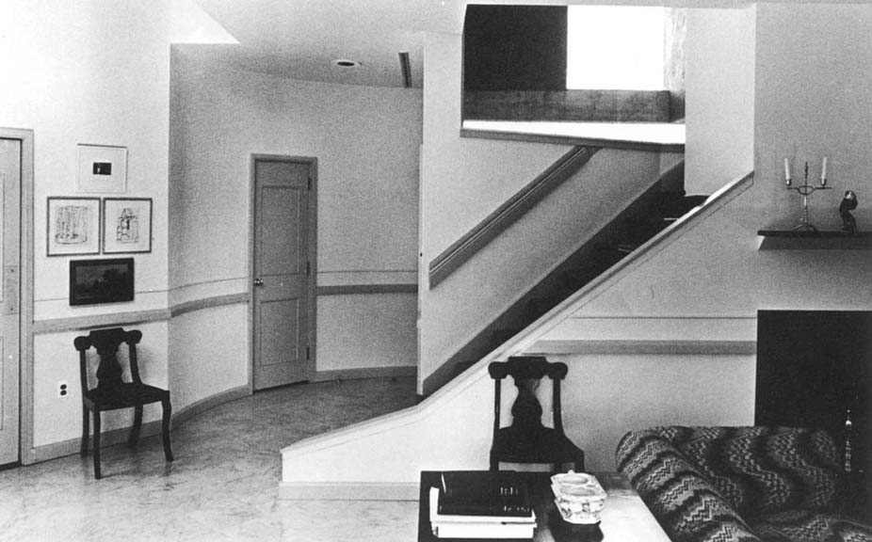

Slide 83
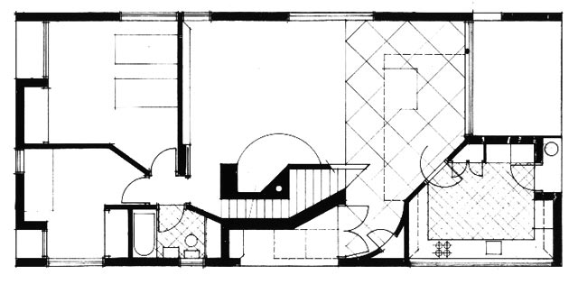
Arch is symbolic not structural.
Windows are opening in the wall not a connection to space as in modernism.
The use of the pediment is a strong historical reference.
Furnishings were eclectic and historical.

Slide 84
At the same time as Robert Venturi…and the rise of Post Modern thinking and designing…there was
American architect Louis Kahn is designing in a classic Modern manner.
Louis Isadore Kahn (1901 – 1974)
an American architect, who spent most of his career in Philadelphia, Pennsylvania, United States.
After working for several firms in Philadelphia, he founded his own atelier in 1935. While continuing his private practice, he served as a design critic and professor of architecture at Yale School of Architecture from 1947 to 1957

Slide 85
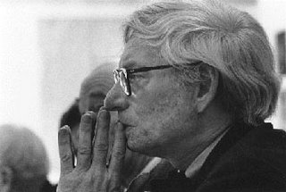
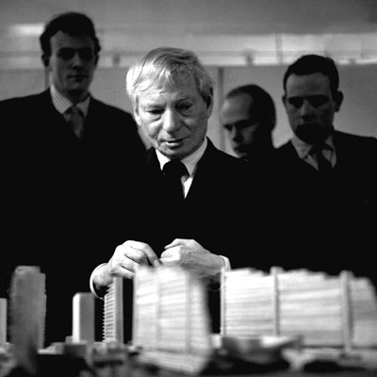
Louis Kahn
From 1957 until his death, he was a professor of architecture at the School of Design at the University of Pennsylvania.
Influenced by ancient ruins, Kahn's style tends to the monumental and monolithic; his heavy buildings do not hide their weight, their materials, or the way they are assembled.

Slide 86
Louis Kahn is widely respected and admired for his deeply thoughtful, almost poetic, approach to design
Louis Kahn's works are considered as monumental beyond modernism.
Famous for his meticulous built works, his provocative unbuilt proposals, and his teaching, Kahn was one of the most influential architects of the 20th century.
Famous statement by Louis Kahn:
"What does the brick want to be? It wants to be an arch."

Slide 87
Phillips Exeter Academy Library, 1965 – 1972 Louis Kahn 'Exeter Library' Video

Slide 88
The exterior is a cube made of bricks, the interior is a geometric play of circles and squares, made of reinforced concrete and wood.

Slide 89
Phillips Exeter Academy Library, designed by Louis Kahn

Slide 90
Phillips Exeter Academy Library, designed by Louis Kahn

Slide 91
Phillips Exeter Academy Library, designed by Louis Kahn

Slide 92
Phillips Exeter Academy Library, designed by Louis Kahn

Slide 93
Phillips Exeter Academy Library, designed by Louis Kahn

Slide 94
Phillips Exeter Academy Library, designed by Louis Kahn

Slide 95
Kimbell Art Museum, Fort Worth, Texas, 1966 – 1972, designed by Louis Kahn

Slide 96
Site plan of the Kimbell Art Museum

Slide 97
Kimbell Art Museum, Fort Worth, Texas, 1966 – 1972, designed by Louis Kah

Slide 98
Vault with light ‘slot’

Slide 99
Kimbell Art Museum, Fort Worth, Texas, 1966 – 1972, designed by Louis Kah

Slide 100
The National Assembly Building of Dhaka, Bangladesh, by Louis I Kahn

Slide 101
Parliament of Bangladesh designed by Louis Kahn

Slide 102
Parliament of Bangladesh designed by Louis Kahn

Slide 103
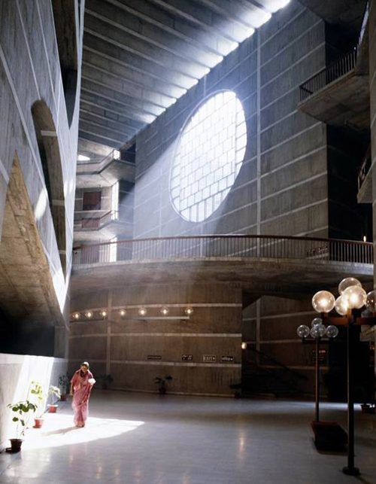
National Assembly (Parliament) in Bangladesh designed by Louis Kahn

Slide 104
National Assembly (Parliament) in Bangladesh designed by Louis Kahn

Slide 105
National Assembly interior

Slide 106
Parliament in Bangladesh designed by Louis Kahn

Slide 107
Salk Institute, California designed by Louis Kahn

Slide 108
Highly expressive of material and construction method

Slide 109
Clear geometry, clear use of material, a formal, almost quiet character

Slide 110
Salk Institute, California designed by Louis Kahn

Slide 111
Louis Kahn was an architect who was dedicated to creating pure human scale experiences by using powerful but simple architectural elements and materials.
Louis Kahn: Silence and Light (a 2 minute video)
Exhibition Tour: Louis Kahn - The Power of Architecture (a 5 minute video)

Slide 112
The following houses are examples of Post Modern design
What makes them Post Modern is:
a sense of playfulness
irreverence toward traditional design sensibilities
intentionally non-functional elements
gaudy, oversized furnishings

Slide 113
East Hampton Residence 1980 designed by Robert Stern
Used elements from the “Shingle Style of the 19th Century
Abstracted broken pediment announces ‘entry.’
The house is a blend of historic memories and “new design”
Intentionally irreverent, referential, (to historic styles) and ‘thumbing its nose’ at high Modernism.
Ridiculous tall chimney.

Slide 116
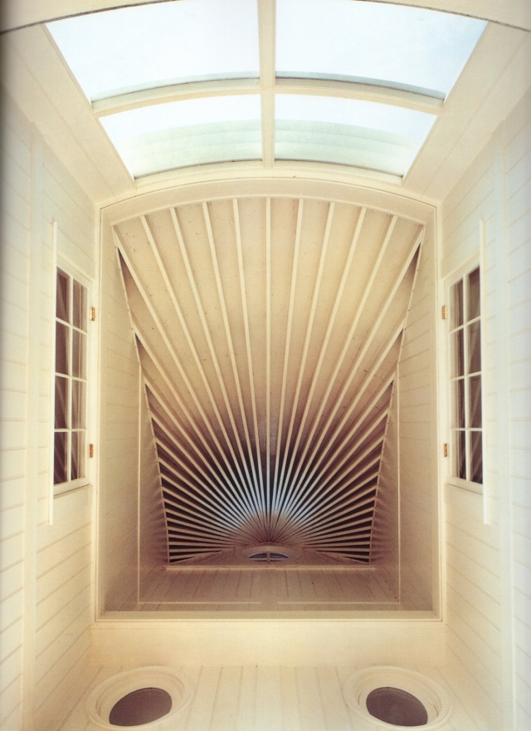

Slide 122
Weekend Michigan Home 1984 designed by Stanley Tigerman and Margaret McCurry
Rectangular shed with second story loft, screened in porch.
Design borrows shape from rural vernacular
Corrugated metal siding and plywood-use of materials found in rural homes
Forms refer to barns and granaries: classic farm buildings.
Interior emphasizes symmetry (classicism)

Slide 127
Gaffney Residence Designed by the Firm of Bohlin, Powell, Larkin and Cywinski
Designed to capture the owner’s memories of time in he Peace Corps and childhood on a Wisconsin Farm
Located in Pennsylvania
The house rests within the stone wall foundation of an old existing barn.
Angled elements, nothing symmetrical.

Slide 129
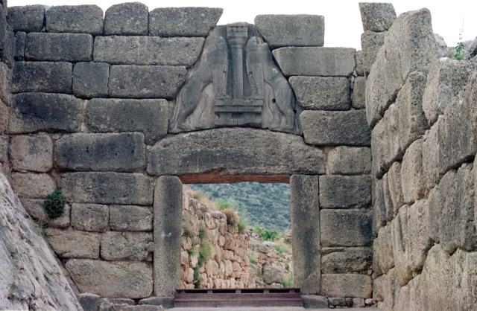

Slide 134
Delaware House (1985) Designed by Venturi, Rauch and Scott Brown
The design is based on 18th Century Vernacular Farm Houses
The facade of the house is flattened.
The Doric columns are flat and are only symbolic of columns. (Constructed from modern materials – plywood)
Use of flattened ornamental elements are continued on the interior.
Use of paint for ornament.

Slide 138
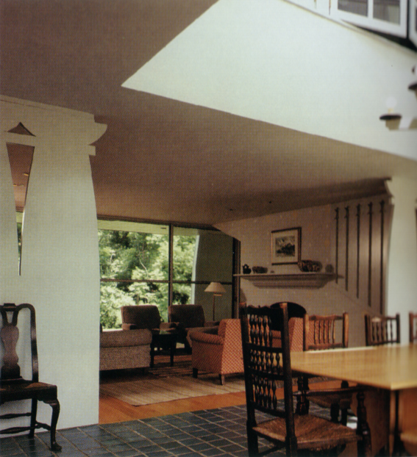
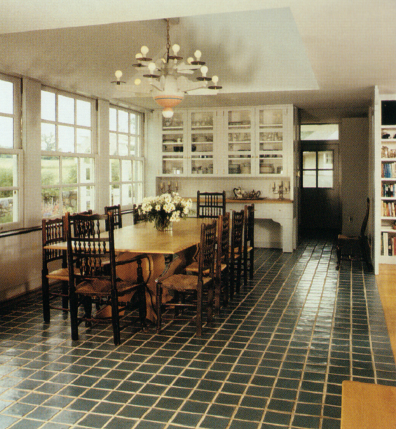

Slide 139
An Aesthetic engagement with the world we encounter DOES affect us, often in multiple ways.
Which of the following two presented meals would you prefer?

Slide 140
Grilled chicken, wild rice and green beans Enjoy!

Slide 141
Chicken, wild rice and green beans. Enjoy!

Slide 142
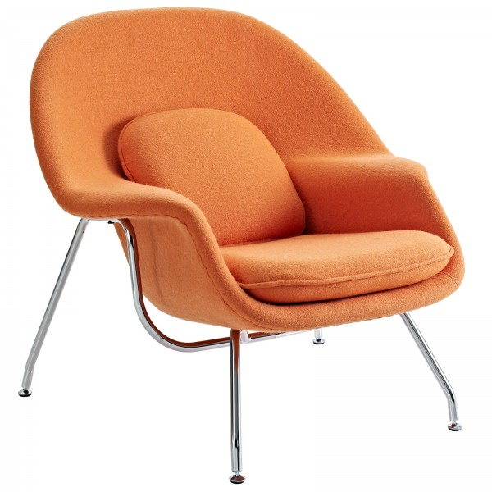
Which chair do you prefer? Anonymous design vs Eero Saarinen ‘Womb’ chair. Both allow you to sit down.

Slide 143
Utilitarian function
Which of these openers do you think is 'well designed'?
Is 'well made' the same as 'well designed'?

Slide 144
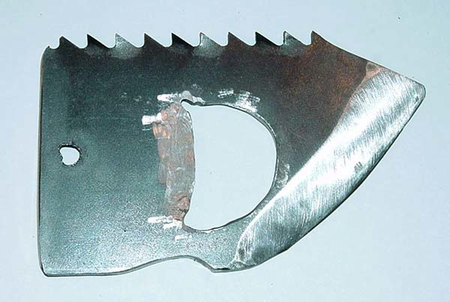
Each of these may be used to open a bottle!

Slide 145
Big Jake’s ‘shiv’ & bottle opener: found in cell block D.

Slide 146
Stainless Steel with matte finish. The Blomus Strato bottle opener, contemporary, stainless steel design. About $10.

Slide 147
Hans Wegner Peacock Chair Designed in 1947 and Produced by Johannes Hansen.

Slide 148
To an architect this Hans Wegner chair is:
visual form
materials used and expressed
joinery and wood working techniques
culturally significant (Danish modern design, 1960’s)

Slide 149
To a structural engineer this Hans Wegner chair is:
material: strength, density, weight, elasticity
response to compression, tension, rotational forces
weight distribution to the four point loaded feet
moisture absorption

Slide 150
To an accountant this Hans Wegner chair is:
cost per unit produced
raw material costs
raw material availability
delivery costs
manufacturing time
time between manufacture and shipping to customer

Slide 151
To think about this Hans Wegner chair in an ‘aesthetic’ way is to:
think about what makes the chair ‘good’ in terms of design:
‘good’ lies at the heart of all aesthetic considerations.
‘good’ touches upon:
visual form, color, texture, scale
material use
functionality
durability
value
cultural significance

Slide 152
An Aesthetic consideration of the Hans Wegner chair can include:
some thought about cost
some thought about material strength
some thought about manufacturing time
some thought about weight disribution
BUT, the primary aesthetic considerations are about:
visual form: why that shape, why that number of pieces
material: as color, texture, pattern, emotional content: wood as a ‘warm’, human material as opposed to metals as ‘cold’ industrial materials.

Slide 153
Aesthetics can touch upon many diverse aspects of a work of design but some are more central, significant, than others.
Broadly speaking it may be helpful to contrast aesthetic issues with ‘pragmatic’ (practical) issues.
“Aesthetic experience involves a drama in which action, feeling, and meaning are one.”
Stanford Encyclopedia of Philosophy

